Slide 1
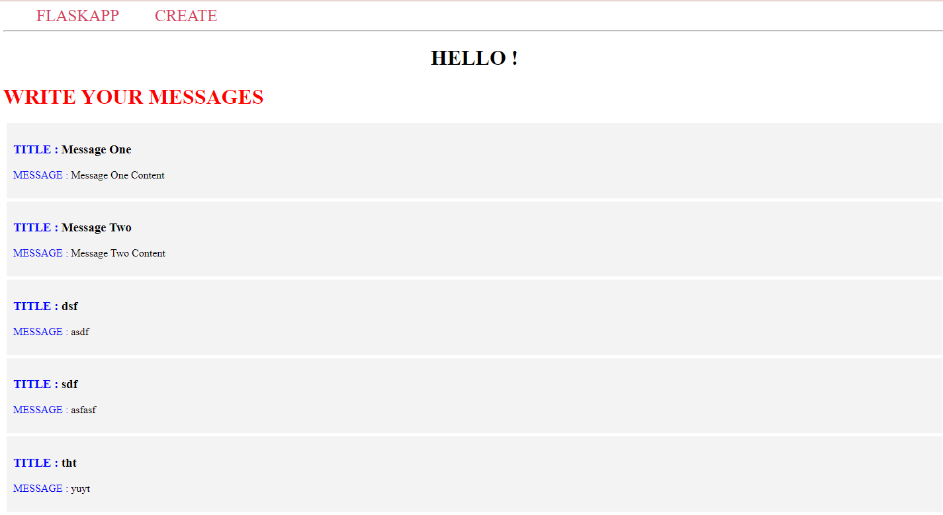
ASSIGNMENT 4
Working with Docker and Kubernetes and deploy as Nodeport

